Slide 1
Integrative Health Care with Behavioral Health Specialists
Eliseo J. Pérez-Stable, M.D.
Professor of Medicine
Division of General Internal Medicine, Department of Medicine
Medical Effectiveness Research Center for Diverse Populations, UCSF
May 29, 2015

Slide 2
Behavioral health integration into primary care
Behavioral health integration into primary care addresses both physical health and behavioral health needs in primary care settings through systematic coordination and collaboration among clinicians
Evidence on clinical effectiveness and cost impact generally limited to mental health conditions, but field evolving to include substance use disorder

Slide 3
Context
High prevalence of behavioral health conditions in population of patients with chronic physical health conditions
Major disparities in access to behavioral health services
Long history of separate treatment and financing of physical and behavioral health
Many efforts to integrate behavioral health and primary care over past 20+ years

Slide 4
Common Features of BHI
Screening for depression, anxiety, and other disorders using validated tools
Team-based care
Shared information systems
Standardized use of guidelines
Systematic measurement of outcomes
Engage broader community services
Individualized, person-centered care that incorporated family members and other supports into treatment plan

Slide 5
Common Challenges
  • Fragmented care reinforced by separate funding and regulations for physical and behavioral health services
  • HIPAA restrictions on disclosure and use of patient information for treatment of substance use and mental health
  • Slower adoption of EHRs by behavioral health clinicians and difficulty with communication

Slide 6
Workforce and Financing
  • Distinct practice cultures between primary care and behavioral health
  • Shortage of behavioral health clinicians and PCPs and lack of training in integrated health care
  • “Carve outs” common: misaligned payment incentives between physical health and behavioral health
  • Higher copayments, lack of codes for billing, limitation on type of clinician

Slide 7
Care Delivery Initiatives
Accountable care organizations
Patient-centered medical homes
ACA provisions:
  Medicaid expansion
  FQHC expansion
Telemedicine

Slide 8
Evidence Review
More than 25 systematic reviews
  AHRQ 2008
  Cochrane collaboration 2006, 2012, 2015
Men and women, any age
≥ 50% with anxiety or depression
Intervention in primary care clinics
Include studies of patients with chronic medical conditions: Diabetes, hypertension, heart disease, pain

Slide 9
Study Description
94 randomized trials with > 25,000 patients
85% in primary care (78/94); 73% in the United States
100% based on the Collaborative Care Model; No trials of co-location in primary care and No studies of integrated, collaborative treatment plan
* Collaborative Care Model is an approach that integrates treatment for mood and anxiety disorders into primary care settings with: 1) care coordination and care management, 2) regular/proactive monitoring and treatment to target using validated clinical rating scales, and 3) regular supervision by a mental health professional
Notes:
Non-primary care: oncology clinics, neurology clinics, HIV, Occupational health, hospital (trauma and CVD).

Slide 10
Results
Health System
  Integrated HMO 30%
  VA 18%
  Non-integrated 47%
  Multiple 5%
Integrated care
  Medication management only 38%
  Psychological therapy only 12%
  Both 50%
Notes:
Non-primary care: oncology clinics, neurology clinics, HIV, Occupational health, hospital (trauma and CVD).

Slide 11
Outcomes: Depression and Anxiety
Change in score
  Continuous measure
Response to therapy
  ≥ 50% reduction in score
Remission
  Reduction in score below threshold
Adherence to medical therapy
Standardized mean difference (SMD)
  Combines continuous outcomes
  Average change / standard deviation
  ~ 0.2 is small, 0.5 moderate, 0.8 large
Notes:
CES-D, HAM-D, PHQ-9, SCL-20, GDS, GAD

Slide 12
Depression Example
IMPACT trial: www.impact-uw.org/about/
  Largest: 18 clinics, 1,801 depressed patients
    California, Indiana, North Carolina, Texas, Washington
    HMO, FFS, IPA, VA & inner city public health clinics with overall diverse sample
    Randomized by patient
  Systematic screening + PCP identified
  Care manager: education, care management, medication management, brief psychotherapy
Notes:
HMOs, VA clinics, FFS, inner city public health clinic, etc. Broad variety. Multiple states: Washington, Texas, Indiana, North Carolina.
The coordinating center is a national resource for others trying to integrate care at their location.
50% referred to study, 50% found by screening.
Both dysthymia and major depression included. Age ≥ 60. Exclude alcoholism, bipolar disease, under treatment by psychiatrist, severe cognitive impairment.

Slide 13
IMPACT Trial Outcomes at 1 Year
 | Collaborative Care | Usual Care | P
Score (SCL-20) | 1.7 to 1.0 | 1.7 to 1.4 | <0.001
Response (≥50%) | 45% | 19% | <0.001
Remission | 25% | 8% | <0.001
Antidepressant use | 73% | 57% | <0.001
Satisfaction with depression care | 76% | 47% | <0.001
Notes:
Symptom checklist 20 (SCL-20) score >= 1.5 is equivalent to major depression; <0.5 = no depression. 20 questions: 0-4 on each; take the average. Thus total score is from 0-4.

Slide 14
Depression Summary
Integrated care improves outcomes (79 studies)
  SMD 0.28, 95% CI 0.23-0.33
  Median absolute increase in response: 18.4%
  Median absolute increase in remission: 16.7%
High certainty of small net benefit
  P < 0.001, consistent, meta-analysis significant in 2000
  The effect size is small to moderate
Notes:
SMD small 0.2, moderate 0.5, large 0.8. ICER lexicon: benefit choices are negative, comparable, small or substantial. Is this a substantial net health benefit?

Slide 15
Anxiety Example
CALM study (modeled on IMPACT study)
  17 clinics, 1,004 patients
  PCPs identified patients
  Panic disorder, generalized anxiety disorder, social anxiety disorder, posttraumatic stress disorder
  Randomized by patient
  Non-expert care managers: education, care management, medication management, brief psychotherapy
Notes:
Mental health specialist made the diagnosis using the Mini International Neuropsychiatric Interview and score ≥ 8 on anxiety severity scale (OASIS, score 0-20, ≥ 8 is moderate).
Ages 18-75, English or Spanish speaking. Depression allowed. Excluded: bipolar, psychosis, severe cognitive impairment.

Slide 16
CALM Trial Outcomes at 1 Year
 | Collaborative Care | Usual Care | P
Score (BSI-12) | 16.2 to 8.1 | 16.3 to 10.8 | <0.001
Response (≥50%) | 64% | 45% | <0.001
Remission | 51% | 33% | <0.001
Appropriate counseling | 49% | 27% | <0.001
Satisfaction with anxiety care | 3.9/5 | 3.4/5 | <0.001
Notes:
BSI – Brief symptom inventory: like SCL20. 12 questions 0-4; take average. Used here because multiple anxiety disorders included: GAD, Panic, PTSD, social phobia.

Slide 17
Anxiety Summary
Integrated care improves outcomes (7 studies)
  SMD 0.33, 95% CI 0.19-0.47
Moderate certainty of small net benefit
  P<0.001, consistent, fewer studies, wider Confidence Intervals
  The effect size is small to moderate
Notes:
SMD small 0.2, moderate 0.5, large 0.8 Same issue: ICER lexicon: benefit is either negative, comparable, small or substantial.

Slide 18
Diabetes and Depression
Seven randomized trials
Depression scores
  SMD 0.32, 95% CI 0.11 to 0.53
Hemoglobin A1c decrease
  0.33%, 95% CI 0.0% to 0.66%
Low certainty of a small net benefit among patients with both depression and diabetes because the A1c benefit is of borderline statistical and clinical significance
Notes:
Substudy (2/18 sites) of Impact: benefit in presenting first CHD events, but not recurrent. Some of the diabetes studies documented improvements in hypertension and lipids as well.

Slide 19
Other medical conditions
Pain: Mixed results in primary studies (IMPACT, RESPECT)
  CCM if depression and chronic pain (n=250) Significant improvements in both (26% vs. 8%)
Heart disease: In specialty clinics or in studies with diabetes –– Insufficient evidence
Quality of Life with SF12 or SF36
  SMD 0.20 to 0.26 through 24 months (p<0.001)
High certainty of a small benefit in mental health QOL

Slide 20
Patient Satisfaction
30/34 studies reported higher satisfaction with integrated care (22/34 with p<0.05)
10 studies used a continuous measure
  SMD 0.31, 95% CI 0.13 to 0.49, p<0.001
Summary: High certainty of small to moderately greater satisfaction with integrated care because of the large number of studies, consistent findings, and low p-value, though the SMD was only 0.31.

Slide 21
Economic Analysis
Care Value: Incremental clinical benefit over usual care but at increased cost
BHI interventions fall within generally-acceptable thresholds for cost-effectiveness ($15-80K per QALY gained vs. usual care)
Health System Value: Economic studies have shown that BHI interventions increase costs, at least in the short term
Evidence on longer-term cost offsets limited to specific subpopulations and/or subject to methodologic concerns
Start-up and ongoing costs of BHI, while variable, likely to represent substantial increase in primary care PMPM but more modest change in total health-system costs
Notes:
QALY gained is ALL from QoL improvement through reduced depression-free days, not survival

Slide 22
Causes of Death
Cigarette Smoking
Language Access

Slide 23
Causes of Death, Latinos and Whites, All Ages, Both Sexes, US 2010-13
Latinos rate
Heart Disease 59.4
Cancer 61.6
Stroke 14.4
Diabetes 13.0
Lung Disease 8.3
Accidents 20.8
Suicide 5.2
Whites rate
Heart Disease 209.6
Cancer 199.8
Stroke 43.3
Diabetes 23.6
Lung Disease 54.8
Accidents 45.2
Suicide 14.9

Slide 24
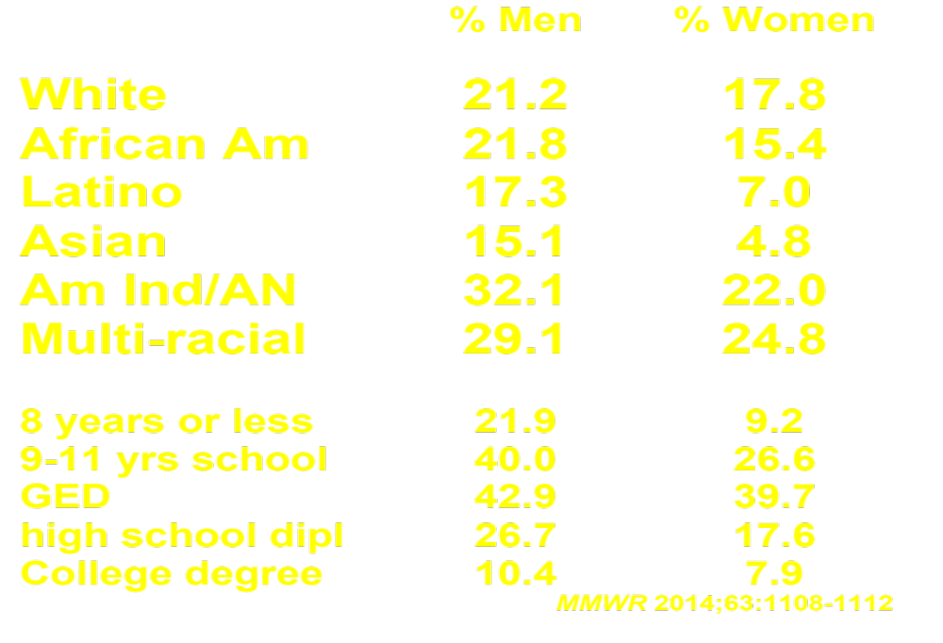
Cigarette Smoking in the U.S. – 2013
National Health Interview Survey

Slide 25
Latino Smoking Behavior: Subjective Culture
Results from Convenient Sample Research
• Less likely to smoke due to habitual cues
As likely to smoke due to emotional cues
More likely to want to quit because of: –cigarette smoke effects on others, especially family
–smoking affects interpersonal relations
–smoking effects on own health

Slide 26






UCSF Update:
Clinical Champions & APeX
E-referral to Helpline* (inpatient/outpatient) | Inpatient Tobacco Order Set | Outpatient Tobacco Smartset
Helpline calls patient in 1-2 days. Sends results message to provider. (Live Fall 2014.) * Referral to UCSF Fontana outpatient counseling already built | Activated by RN & RT. Revisions include: 1) E-referral 2) Assistance to smokers not interested to quit | Coming in 2015. Gen Med piloting LVN counseling after visit.
Notes:
At UCSF, we have clinical champions who are part of UC Quits, helping to improve and conduct outreach on the tobacco cessation workflow for the inpatient and outpatient settings. These clinical champions include Sujatha Sankaran (inpatient and Fontana Treatment Center champion), Eliseo Perez-Stable (outpatient champion), Mai-Khanh Bui-Duy (outpatient), Jyothi Marbin (peds), Suzanne Harris (Fontana Treatment Center nurse), and Lisa Kroon (pharmacy). Several APeX modifications make it easier for providers to document advise to quit or eliminate smoke exposure, prescribe medications, and refer for counseling. UCSF has the Helpline e-referral going live this fall, a revised inpatient tobacco order set, and plans to adopt an outpatient smartset.

Slide 27
Limited English Proficiency and Health Outcomes
LEP status is associated with less health information given to patient, harder access to care, longer waits
Effect on clinical outcomes varies
Shortage of clinicians who speak other languages: Language discordance is common
Interpreters are often not available and infrequently used
15.5 million LEP Latinos in 2010
Notes:
27

Slide 28
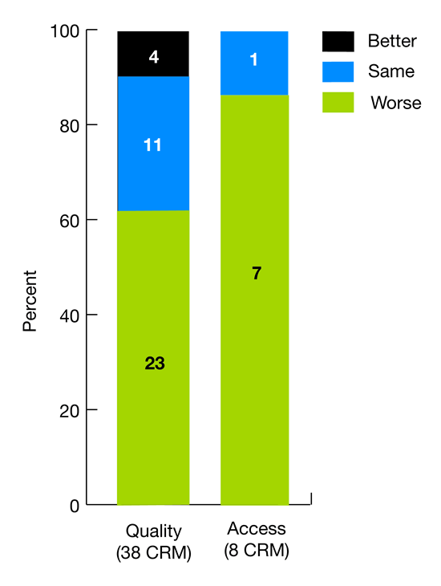
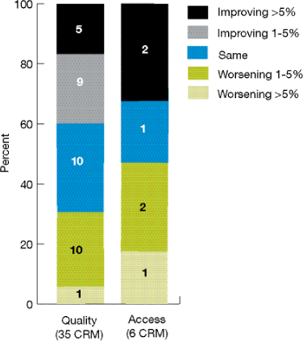
Latinos have poorer quality of care & worse access to care than Whites

Slide 29
Language Access Recommendations
Standard two questions to assess LEP status on all patients
Language concordance is optimal
Certify clinicians and give credit
Train more diverse clinicians
Professional interpretation must be the standard – need more time

Slide 30
Final Points
Behavioral health integration in primary care has potential: PCMCH
Target behaviors that affect health: substance use, prevention, nutrition
Common mental health disorders
Focus on patients with chronic disease, high resource utilizers in making economic case

