Slide 1

Behavioral Intervention Technologies and Psychotherapy with Latino Youth
Eduardo Bunge* Ph.D.
Rosie Perales
Palo Alto University
*Associate Director of I4Health;
*Director of CAPT
Latin@ Behavioral Health Forum

Slide 2
Structure this slide will be hidden:
I come from the clinical field, I was concerned that our efforts were not enough.
Basically because 80% do not receive treatment, the outcomes are poor etc.
Plus, there is a significant number of Latino youth that we wont be able to reach
May be technology could help us???
But latinos don’t have access to technology???
Well data shows that yes they do have access….
Psychology field is increasing the interest in technologies for youth
  As shown by the growing number of publications
  Let see some examples of interventions
Ok, this sounds intersting but, how many of this studies included latinos??
  Table with percentages
  Very little is known about how this interventions could help latino youth
Call for action.
  There is a huge need of improving resources
  latinos use technology more than whites,
  little has been done, let’s start working on it…

Slide 3
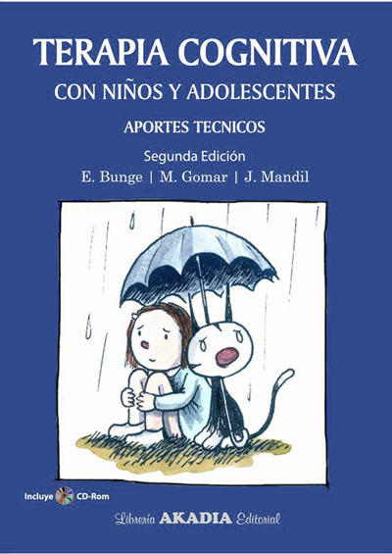
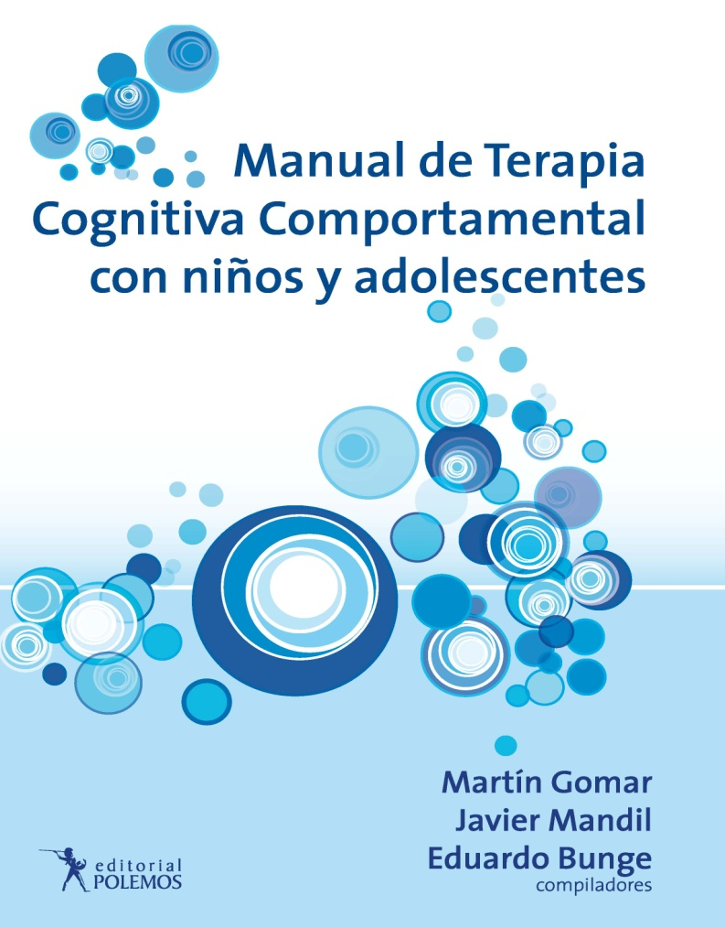
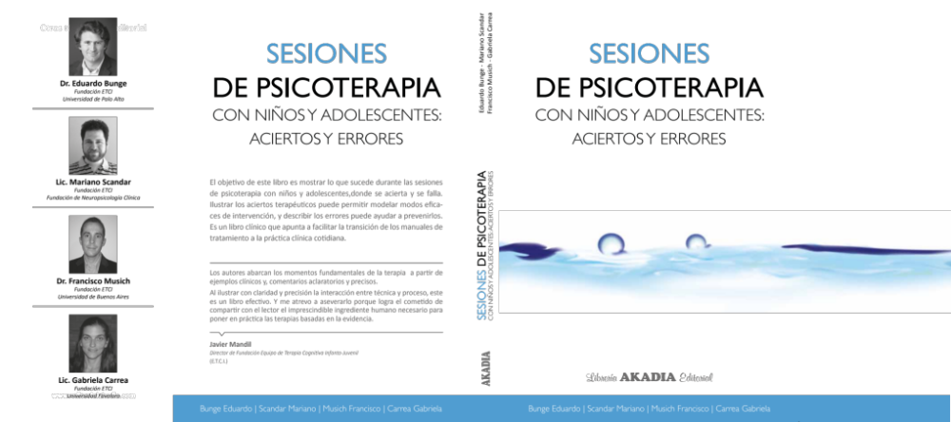
Not enough

Slide 4

psychological disorder
(NRC and Institute of Med, 2009)
Notes:
20 % of children and adolescents have a diagnosable psychiatric disorder (NRC and Institute of Med, 2009)
Estado actual de la psicoterapia
Chicos que no reciben tratamiento.
Cuando lo reciben no es bueno
Cuanto les gusta ir a terapia?
2 anecdotas telefono y amigos
Papel vs iphone.
Nuevas modalidades de relacion

Slide 5
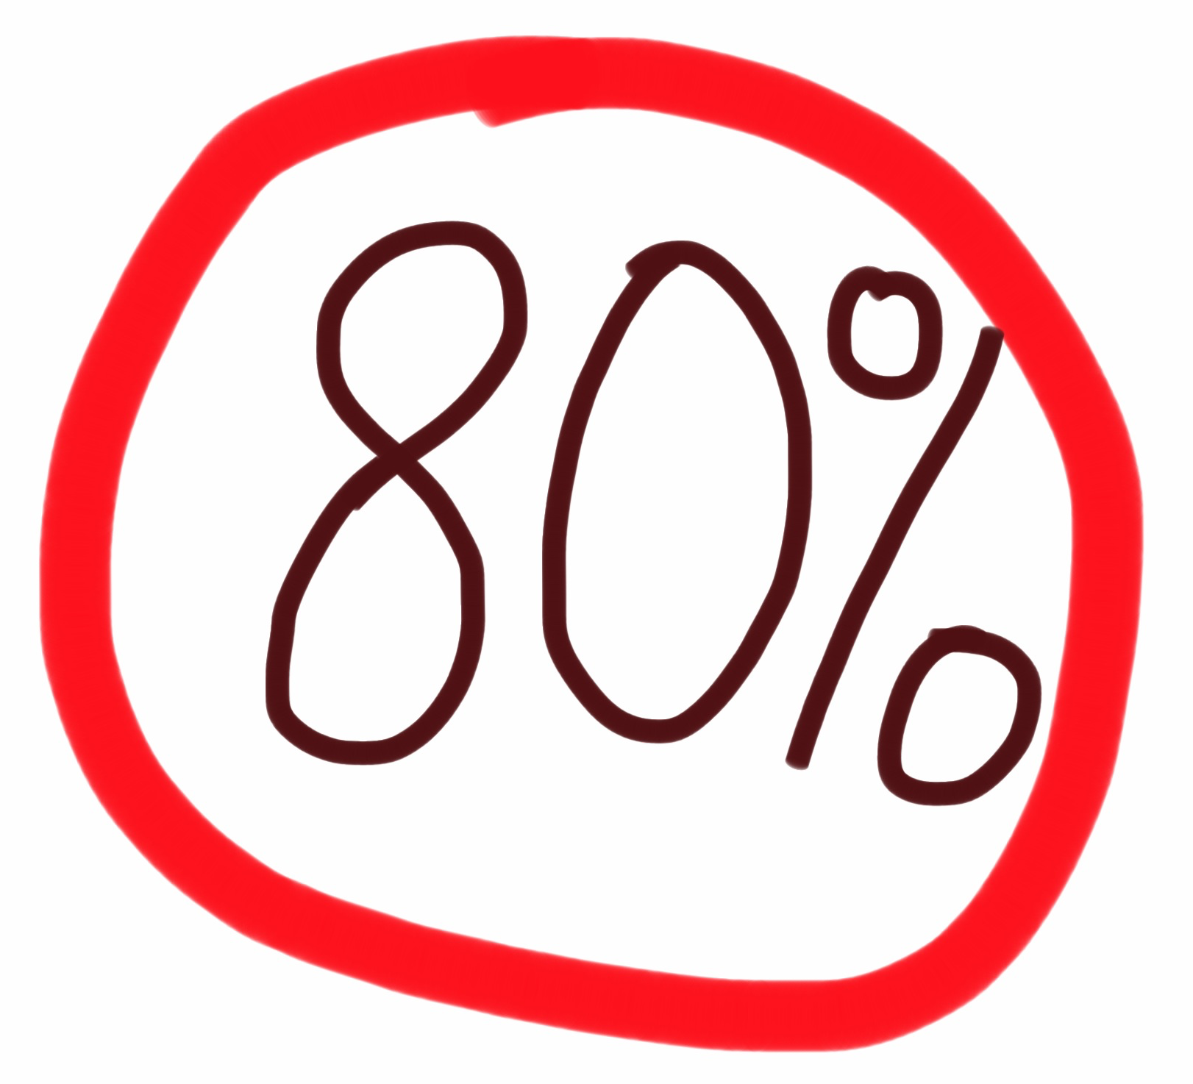
do not receive care
(Kataoka, 2002)
Notes:
do not receive care (Kataoka, 2002)

Slide 6

Usual Care
  44% improved
  32% no reliable change
  24% deteriorated
      (Warren et al., 2010)

Slide 7
Latino Youth:
  1 in 4 youth are Hispanic
  2013 = 17.5 million in US
  2050 = 35.6 Latino youth are expected in US
  52% of Hispanic youth live in California
  (Murphey, Guzman, & Torres, 2014)
Notes:
Stats citation: http://www.childtrends.org/wp-content/uploads/2014/09/2014-38AmericaHispanicChildren.pdf
Of the 74 million children in the United States today, 17.5 million are Hispanic.a They
are the largest racial/ethnic minority group of children, and also the fastest-growing.
Today, one U.S. child in four is Hispanic; by 2050, it will be more than one in three,

Slide 8
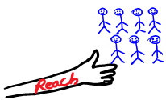

Can technology help?
Light savor
Notes:
We need better tools if we want to reach more children and if want to have better outcomes

Slide 9
“We Latinos Don’t Use Technology!”
Hispanic youth are more likely than non-Hispanic youth to own a smartphone (43% or 7.5 million)
  Non-Hispanic White= 35%
  Non-Hispanic Black= 40%
  (Murphey, Guzman, & Torres, 2014)
Notes:
Stats citation: http://www.childtrends.org/wp-content/uploads/2014/09/2014-38AmericaHispanicChildren.pdf
Scary statistic
Cell phone experience-anecdote
Numbers to acompaniar the anecdote, latinos use more smarthphones than white…
“We latinos don’t use technology”
Explicar bits y dar ejemplos, tipo Sparx, y agregar una tabla con los porcentajes. Asi presento todo

Slide 10
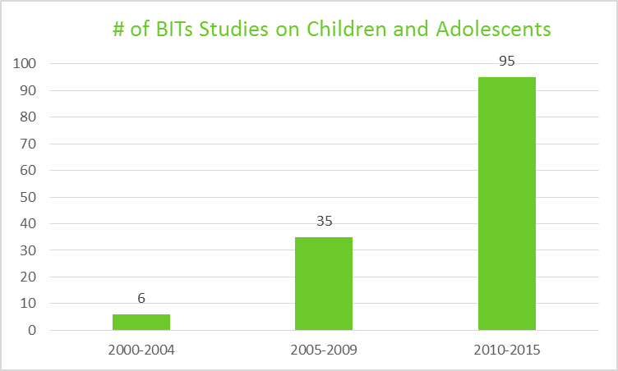
* Includes: RCTs, case studies, feasibility studies
Dickter, Alie, Jones, & Bunge (n.d.)
Notes:
Authors: Benjamin Dickter, Gennifer Alie, Megan Jones, and Eduardo Bunge
University Affiliation: Palo Alto University
Introduction: Behavioral intervention technology (BIT) has the capacity to reach large quantities of people, generate affordable access to therapy, and increase the frequency of therapist-client communication. In addition, children and adolescents find BIT to be more approachable in comparison to clinical sessions. Thus, an analysis of the current research of BIT enhanced CBT may be useful in determining the progression of the field. Goal: Produce a bibliometric study to establish the quantitative research publication output of youth ages 2-17 and Cognitive-Behavioral Therapy (CBT) as it relates to BIT. Analysis of this output was designed to determine evolving trends in the research in regards to modality and disorder treated across time. Methods: The literature search was accomplished by including peer-reviewed articles found through EBSCOhost that mentioned terms related to children and adolescents, BIT, DSM-5 disorders, and CBT. An analysis of frequency of disorders and modalities researched was conducted. The three time points were defined as: 2000-2004, 2005-2009, 2010-2015. Results: In total, 136 articles were identified, addressing the following disorders: Depressive Disorders (n=46, 33.8%), Anxiety Disorders (n=45, 33.1%), Attention-Deficit Hyperactivity Disorder (n=30, 22.1%), Conduct Disorder (n=9, 6.6%), Obsessive-Compulsive Disorder (n=8, 5.9%), Post-Traumatic Stress Disorder (n=4, 2.9%), Substance Use (n=2, 1.5%), Autism Spectrum Disorder (n=2, 1.5%), and Disordered Eating (n=1, 0.7%). Eleven modalities were identified: Internet Delivered (n=52, 38.2%), Computer Delivered (n=26, 19.1%), Virtual Reality (n=14, 10.3%), Computer+Therapist (n=8, 5.9%), Telephone Assisted (n=8, 5.9%), Video Conferencing (n=7, 5.1%), Video Game (n=6, 4.4%), Video Enhanced (n=6, 4.4%), Smartphone App (n=6, 4.4%), CD-ROM (n=2, 1.5%), and Robot Assisted Treatment (n=1, 0.7%). Additionally, the number of studies published during 2000-2004, 2005-2009, and 2010-2015 were 6, 35, and 95 respectively. Conclusion: Within the last 15 years, BIT-based research has focused mainly on the treatment for depression and anxiety disorders with less emphasis on other youth disorders. The most frequently used modalities included Internet Delivered and Computer Delivered treatments. In the last 5 years, research provided significant growth than in the previous decade. BIT enhanced CBT for youth is still an emerging field, and more research is recommended to further develop and disseminate mental health services.
Keywords: behavior intervention technology, bibliometric study, cognitive-behavior therapy, children and adolescents
2000-2004: 6
2005-2009: 35
2010-2015: 95

Slide 11
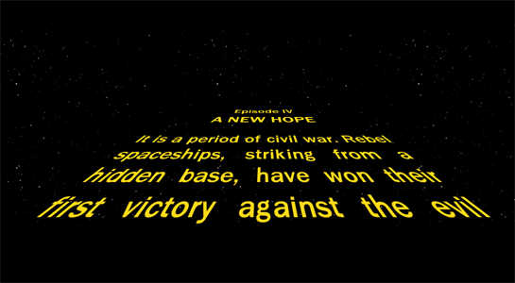
Some examples
Notes:
So let see some examples of how tech and psych can work together…

Slide 12
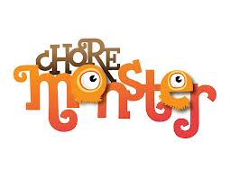
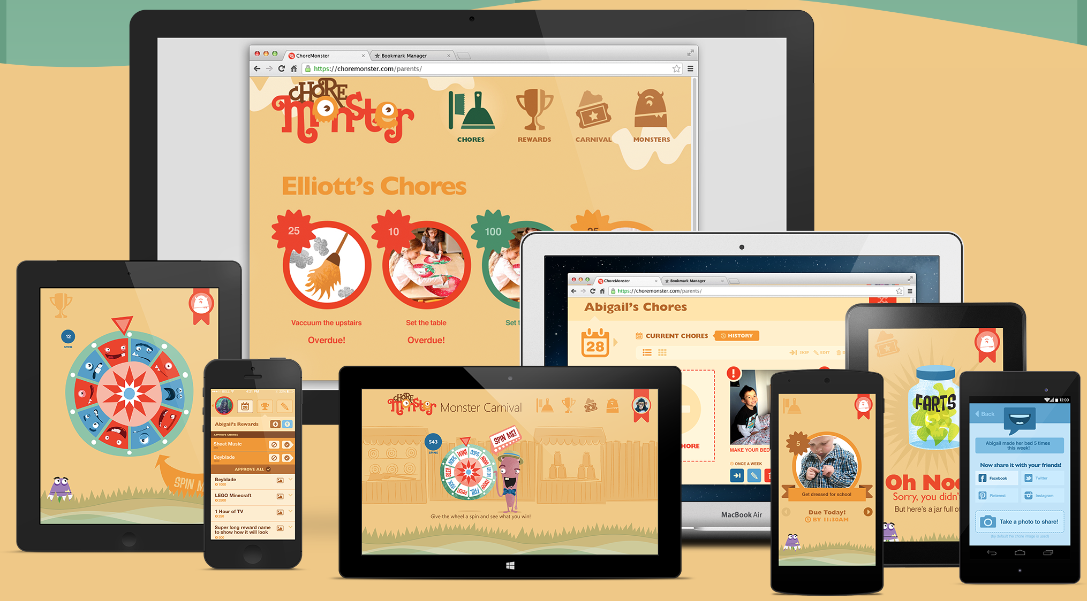
Notes:
"How may of you have considered setting up a reward system to get your children to do their homework or help with chores around the house?
And how many haven't done it because it is complicated to set one up? Well, now there is an app for that! -- [then describe the app, saying that it allows the parent and child to set up the system, decide on what they will get points for, and allows the parent to award the points and the child to see them adding up....]
Although based on principles well established, it was not tested scientifically

Slide 13

(Van Voorhees, 2010)
Notes:
Some interventions that have been tested..
Prevention of depression in adolescents, in collaboration with a PCP. The PCP helps them minimally to get started…this expands our resources.

Slide 14

(Kannah & Kendall, 2011)
Notes:
Example for anxiety
First phase of the treatment, help of someone to get the program….

Slide 15
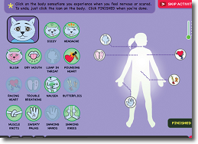
(Kannah & Kendall, 2011)
Notes:
Graphicall way to show, teach, about anxiety

Slide 16
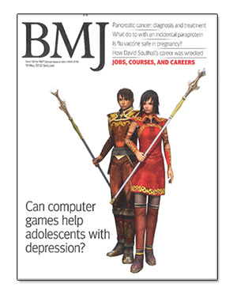
(Merry, 2012)
Notes:
Videogames seems like a reasonable option..
This is the only one studied to date.
Sparx

Slide 17
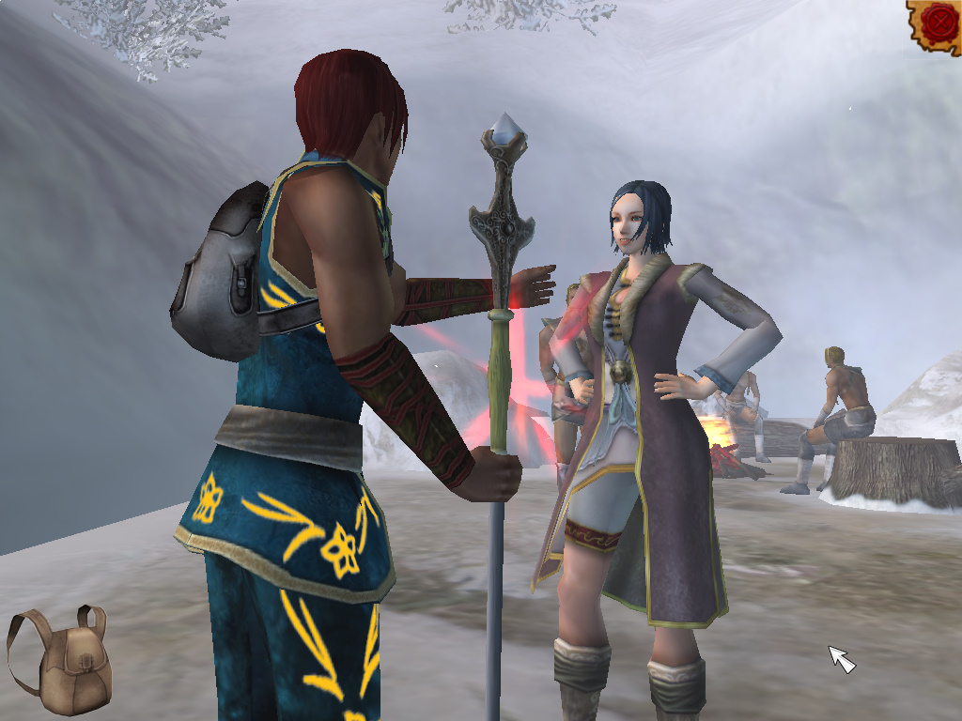
Sparx
Notes:
Instead of killing the bad guys, you need to fight against the neg thoughts…
Unfortunately it is not available to the public, is from NZ

Slide 18
Are There Any Interventions Specifically Designed for the Latino Population?
67 BIT outcome studies worldwide
Only 2 studies looked at Latinos
    Ramos, Piqueras & García-López (2008)
      Spain
    Gutierrez-Maldonado, et al. (2009)
      Spanish researchers
      Mexican participants

Slide 19
How Many BITs Studies Included at least some Latino Participants?
12 studies (N = 67, 18%)

Slide 20
What Percentage of Latino Participants Were Included in Each BIT Study for Youth?
Notes:
1st I checked every study (worldwide)
Makes no sense (NZ, AU, don’t include latinos)
2nd I started to focus only on US studies

Slide 21
Author | Year | Type of BIT | % of Latinos Participants | # of Latino Participants (n)
Depression
Van Voorhees et al. | 2008 | CATCH-IT | 5 | 4
Van Voorhees et al. | 2009 | CATCH-IT | 5 | 4
Marko et al. | 2010 | CATCH-IT | 5 | 4
Anxiety
Ramos, Piqueras, & Garcia-Lopez | 2008 | Video feedback | 100 | 50
Gutierrez-Maldonado et al. | 2009 | Virtual Reality | 100 | 36
Bechor et al. | 2014 | Computer-Aided Attention Bias Modification Training | 81 | 4
Khanna & Kendall | 2010 | Camp Cope-A-Lot | 2 | 1
Crawford et al. | 2013 | Camp Cope-A-Lot | 12 | 2
OCD
Storch et al. | 2011 | FCBT via Web Camera | 3 | 1
Disruptive Behaviors (ODD, CD, ADHD)
Taylor et al. | 2008 | Computer-based the Incredible Years | 18 | 16
Chacko et al. | 2014 | CogMed Working Memory | 34 | 15
Lavigne et al. | 2011 | Computer-Assisted Management | 12 | 32
Notes:
How many Latino is the percentage?
Put on a plain slide

Slide 22
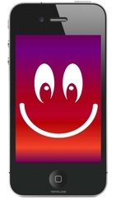

Notes:
Call for action.
There is a huge need of improving resources
latinos use technology more than whites,
little has been done, let’s start working on it…

Slide 23

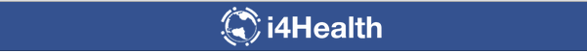
Muchas Gracias
Eduardo Bunge Ph.D
Rosie Perales
ebunge@paloaltou.edu
Notes:
That being said….

Slide 24
This slides wont be included

Slide 25
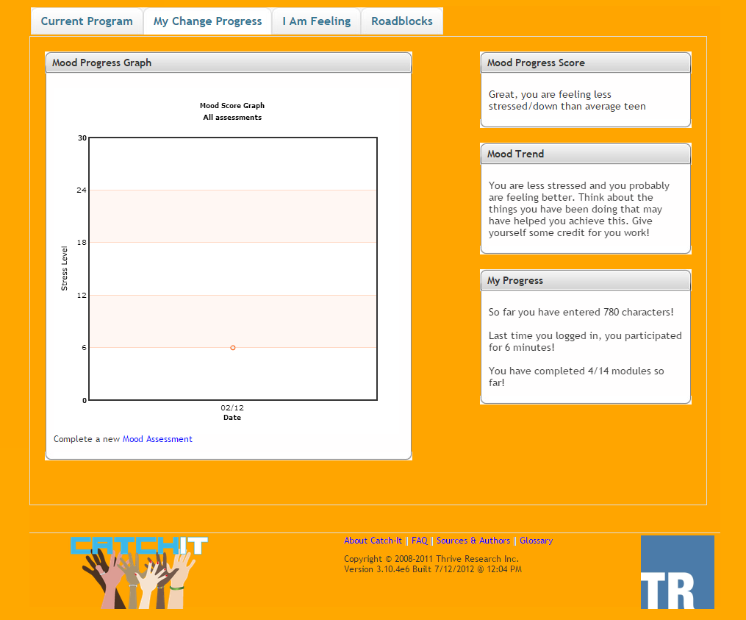
Evidence Based BITs for Depressive Disorders in Youth
Three studies
  Internet-based depression prevention intervention for adolescents in primary care
  CATCH-IT + PCP
  Latinos =
    4.8% (Van Voorhees, 2008)
    5% (Van Voorhees, 2009)
    4% (Marko , Fogel, Mykerezi, & Van Voorhees, 2010)
Notes:
Rosie, por favor agregar una screen shot de catch it en esta slide
low cost, socio-culturally relevant,
easily implemented. The intervention
named ‘‘CATCH-IT’’ (Competent Adulthood
Transition with Cognitive-behavioral, Humanistic
and Interpersonal Training) includes an initial motivational
interview in primary care to engage the adolescent, fourteen

Slide 26
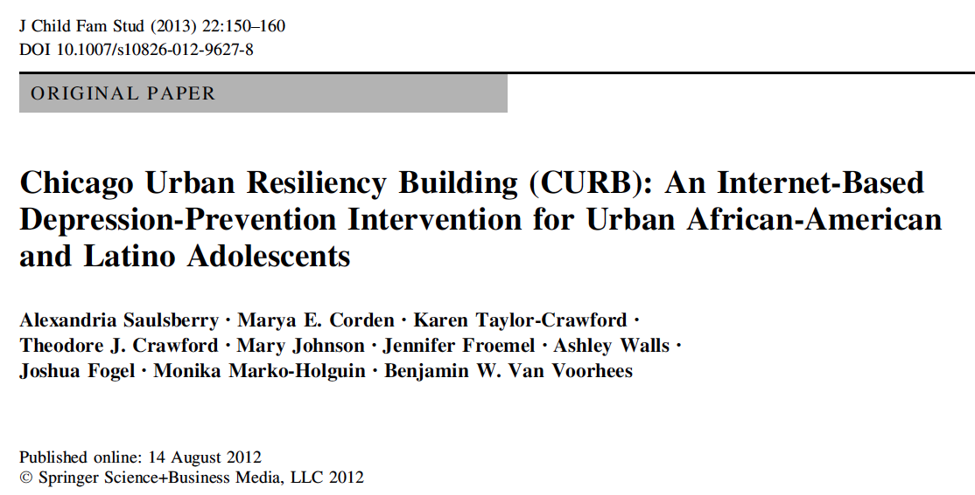

Slide 27
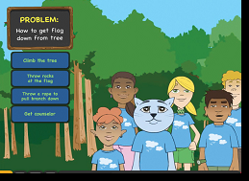

Evidence-Based BITs for Anxiety in Youth
Five studies
Video feedback for Social Anxiety = 100% Spanish
    Ramos, Piqueras & García-López (2008)
Virtual reality for School Phobia = 100% Mexican
    Gutierrez-Maldonado et al. (2009)
Computer-Aided Treatment for – Attention Bias Modification Training = Latinos= 81%
    Bechor et al. (2014)
Camp Cope-a-Lot
  Latinos = 12%, Khanna, & Kendall (2010)
  Latinos = 2%, Crawford et al. (2013)
Notes:
Crawford EA, Salloum A, Lewin AB, Andel R, Murphy TK, Storch EA. A Pilot Study of Computer-Assisted Cognitive Behavioral Therapy for Childhood Anxiety in Community Mental Health Centers. Journal of Cognitive Psychotherapy. 2013 Aug 1;27(3):221–34.
Khanna MS, Kendall PC. Computer-assisted cognitive behavioral therapy for child anxiety: Results of a randomized clinical trial. Journal of Consulting and Clinical Psychology. 2010;78(5):737–45.
Ramos V, Piqueras JA, García-López L-J. Análisis de la eficacia y eficiencia del empleo del Videofeedback en el tratamiento de adolescentes con un trastorno de ansiedad social. Clínica y Salud. 2008;19(2):249–64.
el componente de Videofeedback en 4 de las 12
sesiones, y que sirvió como grupo control. El segundo grupo recibió el mismo
programa de intervención pero el componente de Videofeedback se incluyó en
10 de las 12 sesiones. Los resultados en el postest y en el seguimiento a los 6
meses mostraron que ambas intervenciones resultaron ser, altamente a la vez
que, igualmente eficaces; no hallándose diferencias significativas en los análisis
estadísticos efectuados en las variables dependientes utilizadas
Gutierrez-Maldonado J, Magallón-Neri E, Rus-Calafell M, Peñaloza-Salazar C. Virtual reality exposure therapy for school phobia. Anuario de psicología/The UB Journal of psychology. 2009;40(2):223–36.
18 participants with high scores on school phobia measures
were randomly assigned to a group of treatment whereas other 18 participants
were assigned to a waiting list group. A specific treatment effect on schoolrelated
fears was found suggesting that exposure by means of virtual environments
might be an effective treatment for school phobia.
Bechor:
This case series presents findings from an open trial of ABMT among six children (four girls; Mage = 11.2 years) who completed a CBT protocol and continued to meet diagnostic criteria for an anxietydisorder. All children completed the ABMT protocol with no canceled or missed sessions. Child self-ratingson anxiety symptoms and depressive symptoms significantly decreased from pretreatment to posttreat-ment, as did parent ratings on child anxiety-related impairment. Parent ratings on child anxiety andinternalizing symptoms displayed non-significant decreases from pretreatment to posttreatment. Thesefindings support the potential promise of ABMT as a feasible adjuvant treatment that reduces anxietyand impairment among child anxiety CBT nonresponders.

Slide 28
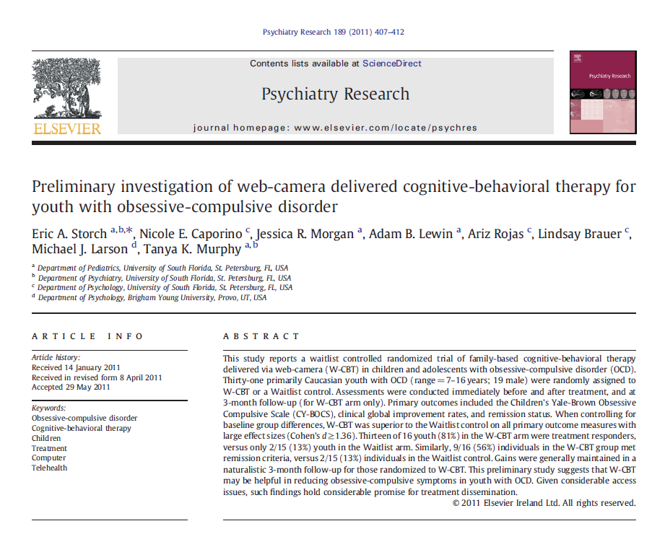
Evidence-Based BITs for OCD in Youth
One Study
Family-based CBT via web-camera
Latinos= 3%
South Florida
Notes:
Storch EA, Caporino NE, Morgan JR, Lewin AB, Rojas A, Brauer L, et al. Preliminary investigation of web-camera delivered cognitive-behavioral therapy for youth with obsessive-compulsive disorder. Psychiatry Research. 2011 Oct;189(3):407–12.
W-CBT was superior to WL on all outcome measures with large effect sizes; 81% were treatment responders; 56% meet remission criteria; gains maintained at 3-month F-up studio hecho por investigadores de south florida, participante de otros estados via web cam. 3% hispanic

Slide 29
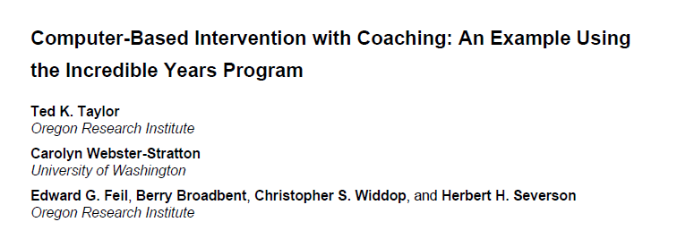
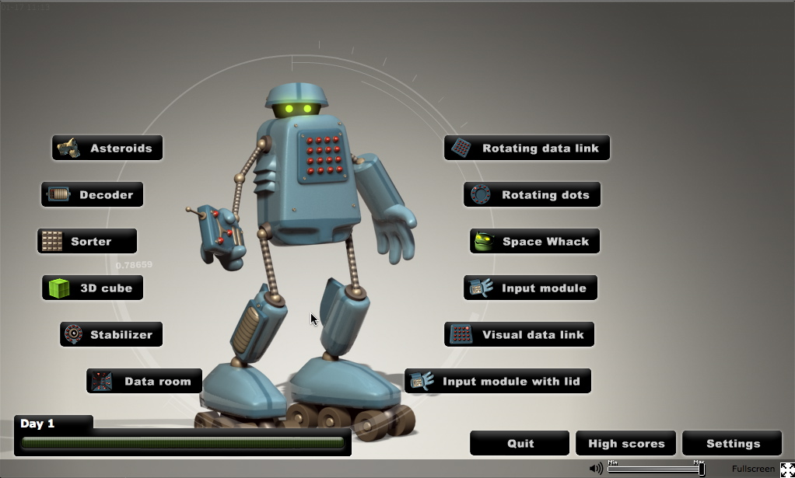
Evidence-Based BITs for Disruptive Behavior Problems
(ODD, CD, ADHD)
ODD: 1 study
Parenting program hybrid model: web-based content + phone calls, electronic messages and home visits (Taylor et al., 2008)
  Latinos = 18%
ADHD: 2 studies
CogMed Working Memory (Chacko et al., 2014)
  Latinos= 34% ⬇
Computer-Assisted Management (Lavigne, 2011)
  Latinos= 12%
Notes:
Taylor TK, Webster‐Stratton C, Feil EG, Broadbent B, Widdop CS, Severson HH. Computer‐Based Intervention with Coaching: An Example Using the Incredible Years Program. Cognitive Behaviour Therapy. 2008 Dec;37(4):233–46.
Chacko A, Bedard AC, Marks DJ, Feirsen N, Uderman JZ, Chimiklis A, et al. A randomized clinical trial of Cogmed Working Memory Training in school-age children with ADHD: a replication in a diverse sample using a control condition. Journal of Child Psychology and Psychiatry. 2014 Mar;55(3):247–55.
CWM Act: targets storage and processing of verbal & non-verbal WM, difficulty level titrated to individual. 25 training sessions, 5 days per week, 30-45 minute sessions. CMW Placebo: active control
No sig. dif. in primary outcome measures between CWM Act and CWM Placebo. Sig. improvements in verbal and nonverbal simple WM (storage) vs. placebo . chacko 2014
Hispanic or Latino 34% y 32%
Conclusions: When a more rigorous comparison condition is utilized, CWMT demonstrates
effects on certain aspects of working memory in children with ADHD; however, CWMT does not appear to
foster treatment generalization to other domains of functioning. As such, CWMT should not be considered a viable
treatment for children with ADHD.
Lavigne JV, Dulcan MK, LeBailly SA, Binns HJ, Cummins TK, Jha P. Computer-Assisted Management of Attention-Deficit/Hyperactivity Disorder. PEDIATRICS. 2011 Jul 1;128(1):e46–53.
CONCLUSIONS: Brief physician training alone did not lead to reductions
in ADHD symptoms, but adherence to a protocol that involved titration
until the child’s symptoms were in the average range and had shown
a reliable change led to better symptom reduction. Computer-assisted
medication management can contribute to better treatment outcomes in
primary care medication treatment of ADHD. Pediatrics 2011;128:e46–e53

Slide 30
Q&A
Are there any BITs specifically designed for the Latino population?
  2
How many BITs studies included at least one Latino participant?
  12 (18%, N=67)
What percentage of Latino participants are included in each BITs study for youth?
  Mean: ~6%
  Median: 0%
  Range: 0-100%
Notes:
2
How many studies included Latino participants?
18% (N=67)
What percentage of Latino/Hispanic participants were included in BITs studies for youth?
Media: XXXX Range 3% -83%
Mean: ~31%
Median: 12%
Range: 2-100%

Slide 31
The Futures of BITs
Emerging field
Few studies & Few participants
Hasty conclusions?
A Call for Action
Notes:
Further research is recommended in developing BIT-based interventions for youth

Slide 32
Final Thoughts
BITs are an emerging and growing field
Little is known about how Latinos respond to these interventions
Further research is recommended in developing BIT-based interventions for youth
  Behavioral problems
  Anxiety disorders
  Depressive disorders

Slide 33
Key Terms
Face-to-Face (F2F)
?
Digital Natives
Behavioral Intervention Technologies
?
Notes:
Face-to-Face (F2F)
Clinician-patient one-on-one psychotherapy
Dominant model of delivering psychological interventions
Digital Natives
The generation of youth that grew up in a world where technology is omnipresent
Behavioral Intervention Technologies
Mobile and electronic interventions that incorporate a variety of technologies, such as mobile phones, the Internet, and virtual reality to assist users in altering behaviors and cognitions related to mental and physical health wellness

Slide 34

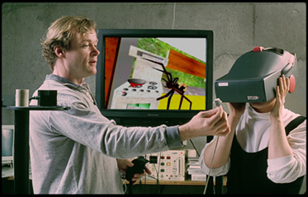
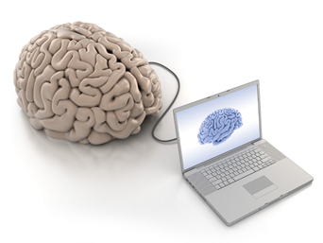
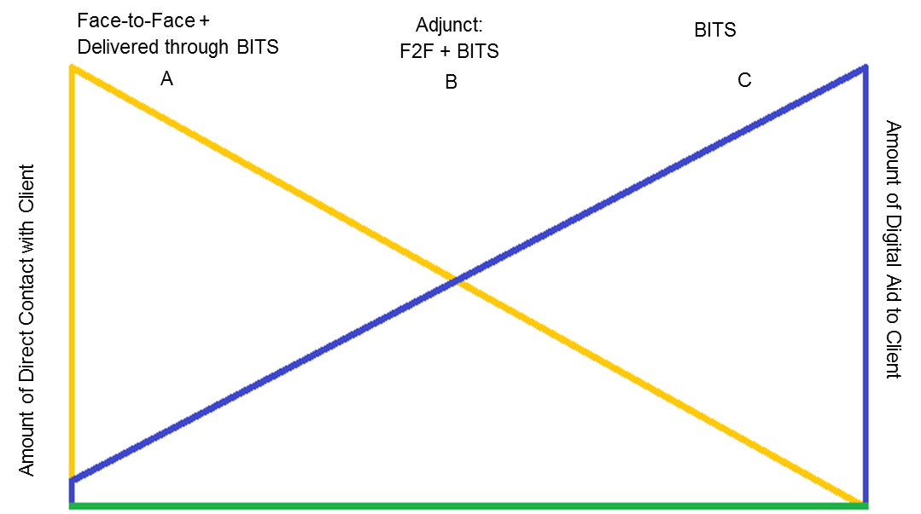
BITs
  Improve therapeutic outcomes
  Increase the reach of mental health resources

Slide 35
restos

Slide 36
The Futures of BITs
A Call for Action
  BITs for Behavioral Problems
    In Latino children, prevalence rates= 3.9% (ODD & CD); 5.6% (ADHD)
    Interventions should target young children and parents
  BITs for Anxiety Disorders
    In Latino, children prevalence rates= 2.5-4.6%
    Interventions should target middle childhood because prevalence increases in this age range
  BITs for Depression Disorders
    In Latino children, prevalence rates= 13%
    Interventions should target adolescence because onset increases in this age range; this disorder generates the most costs
Notes:
Further research is recommended in developing BIT-based interventions for youth

Slide 37
Selection Process of Articles
Search was conducted in December 2014
Databases Included:
  (a) PsycINFO (b) PsycARTICLES (c) PsycBOOKS (d) Psychology and Behavioral Sciences Collections (e) Mental Measurements Yearbook with Tests in Print (f) Ebook Collection (EBSCOhost) (g) Academic Search Premiere (h) MEDLINE with Full Text (i) PsycTESTS (j) Ebook Academic Collection Trial (k) Funk and Wagnalls New World Encyclopedia (l) Health Source – Consumer Edition (m) Health Source: Nursing/Academic Edition.
Key Words:
  children and adolescents
  digital technologies
  mental disorders
Inclusion Criteria:
  Depressive Disorders, Anxiety Disorders, PTSD, OCD, ADHD, CD, and ODD.

Slide 38
Evidence Based BITs for Depressive Disorders in Youth
21 studies
  Web-based interventions (9–27)
  Video game (28–30)
  Online chat treatment (31)
  Mobile phone intervention (32)
  CD-ROM interventions (33,34)
    How many studies included Latino/Hispanic participants and in what percentage?

Slide 39
Evidence-Based BITs for Anxiety in Youth
17 studies
  CD-ROM-delivered treatment (35–39)
  Telephone-delivered guidance (40)
  Computer-Aided Treatment (41,42)
  Internet-based interventions (43–49)
  VR Treatments (50,51)
    How many studies included Latino/Hispanic participants and in what percentage?

Slide 40
Evidence-Based BITs for PTSD & OCD in Youth
8 studies in total
PTSD
  videogame called Coping Coach
OCD
  Video-conference (VC) (54–56)
  One video game (57)
  One mobile application (58)
  One use of the telephone (59)
  And one Internet site (60)
    How many studies included Latino/Hispanic participants and in what percentage?

Slide 41
Evidence-Based BITs for Disruptive Behavior Problems
(ODD, CD, ADHD)
15 studies total
Three websites (61–63),
Two video recordings (64,65),
One telephone-based (66),
One DVD intervention (67).
Two computer-based (68–73),
One CD-ROM-based (74),
One teleconference-based intervention(s) (75)
      How many studies included Latino/Hispanic participants and in what percentage?

Slide 42
Initial search + Hand search
7179 articles
Removed unrelated journals. Removed non-peer-reviewed articles and duplicates (6348)
830 articles screened for relevance
Applied inclusion/exclusion criteria to remove 577 articles from the pool
253 articles
Excluded reviews, meta-analyses, and feasibility studies (186)
67 articles included in this review
Figure 1: Method of article retrieval and inclusion in systematic review, 31st December 2014

