Slide 1
Using technology to address postpartum depression in local and global communities of Latinas
Alinne Z. Barrera, Ph.D.
Palo Alto University
Innovations in Latin@ Behavioral Health Forum
Friday, May 29, 2015

Slide 2



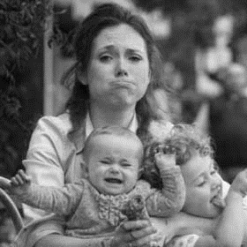
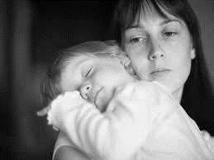
Prenatal/Antenatal
Postpartum
[usually 1-3 years]
Perinatal Period
A majority of cases go undetected and, consequently, untreated!
(World Federation for Mental Health, 2012)
Depression/Sadness
Baby blues
Postpartum depression
(O’Hara & Swain, 1996; World Federation for Mental Health, 2012)

Slide 3
Untreated depression during pregnancy
Continued mood disturbances
Reduced attention to prenatal care
Impact on child development
Harm to self or others
Reduced self-care
Impact on bonding, attachment
More?

Slide 4
Depression among perinatal Latinas
In the U.S., Latinas are at an increased risk for PPD due to immigration, higher rates of life and economic stressors, and interpersonal conflict (Diaz, Cooper, Muñoz, & Le, 2007)
  Depression among pregnant and postpartum Latinas is as high as 56% (Chaudron et al., 2005; Lara et al., 2009; Zayas et al., 2003)
PPD among women in Spanish-speaking countries ranges from 17-35% (Bonilla-Sepúlveda, 2010; Jadresic et al., 2007; Melo et al., 2012; Tannou et al., 2008)

Slide 5
Potential barriers to depression treatment among perinatal Latinas
Language
Health literacy
Variability in symptom expression
Coping strategies: reliance on self
Engagement: Trust and privacy
(Lara-Cinisomo et al., 2014)

Slide 6
Prevention Interventions for PPD
Prevention interventions are effective at reducing the risk of PPD among non-depressed pregnant and postpartum women (Dennis & Dowswell, 2013)
  Few trials have used innovative methods to reach perinatal women.
Technology based interventions are a possible solution to identifying, preventing, and treating depression
  Internet
  Computerized
  SMS
  Telephone

Slide 7
Technology
Technology-based interventions are particularly well suited for pregnant women given:
  Privacy
  Self-paced and accessible 24-hours a day
  Accessible to individuals who are less inclined to seek psychological services
  Pregnant women screening positive for depression can be encouraged to seek medical and psychological consultation

Slide 8
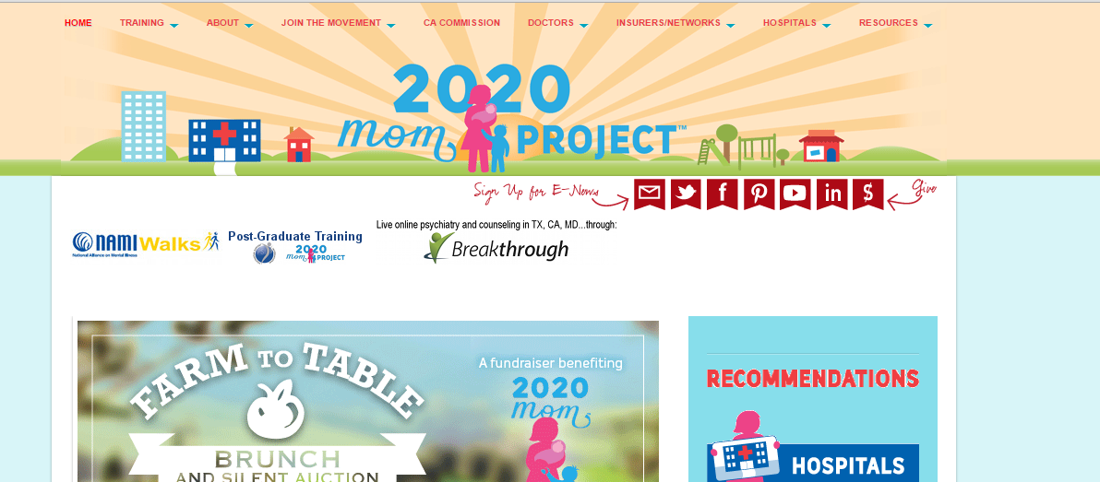
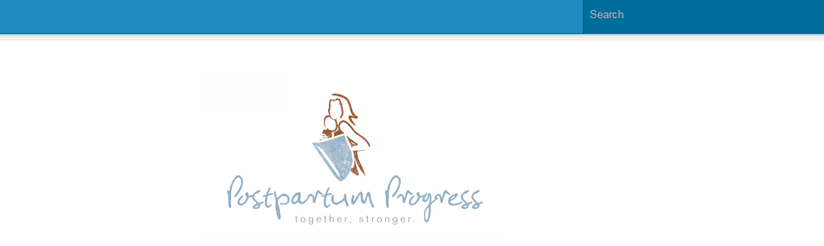
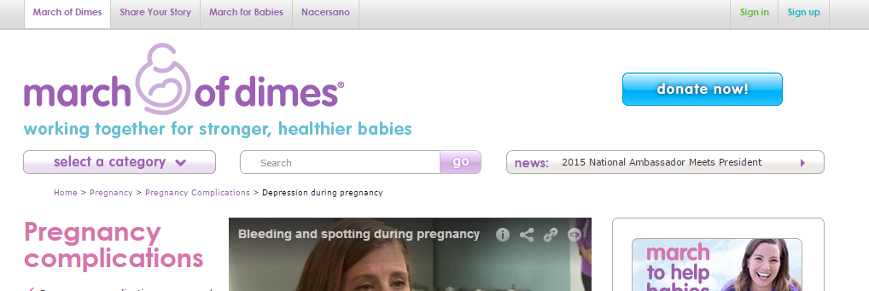
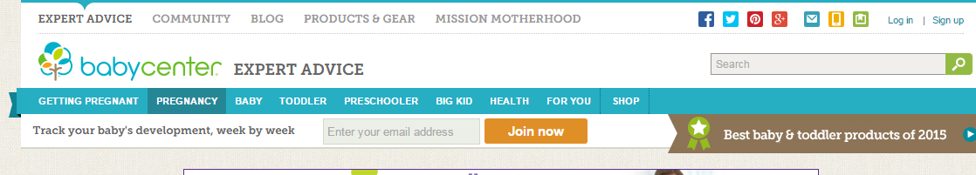
Technology
Countless websites exist that provide information on perinatal health.
  depression during pregnancy = 33,000,000 sites
  depression after birth = 142,000,000 sites
  (Moore, & Ayers, 2011)

Slide 9
Technology
Pregnant women are using technology (e.g., Larsson, 2009)
  Accessed throughout the day
  Email, social media, Internet search
  Younger women more willing to use mobile technology
In a global community of mostly Spanish-speaking pregnant and new mothers (N=509) (Osma & Barrera, 2015)
  44.2% access the Internet at home and/or by mobile device (43.8%)

Slide 10

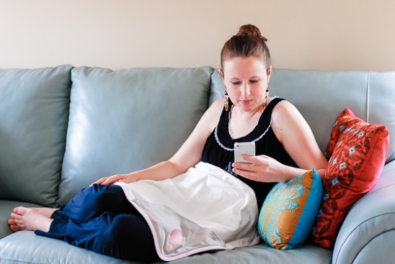

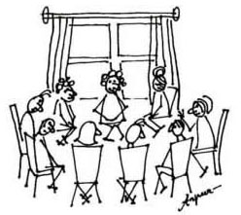
Prevention intervention topic and delivery preferences
Prenatal physical and emotional health and infant development
Baby’s health and care
Prenatal and postpartum
emotional state
[and]
Communication with partners
MOST
preferred
With partners:
Improving communication
Child development/care
Least
preferred

Slide 11
Technology
The Internet is a useful tool to recruit/screen for PPD
Telephone-based peer support effective in preventing postnatal depression among women at high risk
Web-based educational materials focused on postpartum depression have been well-received by clinicians
Text messaging programs for depressed mothers are acceptable, feasible, and low cost
  Few differences between age, race, income, older children
  (Broom et al., 2015; Dennis et al., 2009; Le et al., 2009; Peragallo Urrutia et al., 2015; Wisner et al., 2008)

Slide 12
Internet interventions for PPD
Demonstrate treatment effects (O’Mahen et al., 2012, 2013 and Danaher et al., 2012)
Potential for prevention effects (Haga et al., 2013; Jones et al., 2013)
Currently, there are no published Internet interventions designed specifically for Spanish-speaking perinatal women

Slide 13

Mothers Babies/Mamás y Bebés Internet Project
Fully automated depression prevention Internet intervention
Recruit global sample of English and Spanish-speaking pregnant women
Two condition pilot RCT

Slide 14
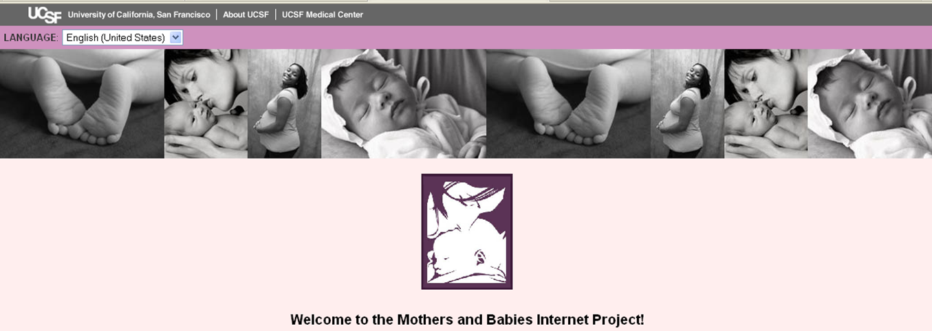
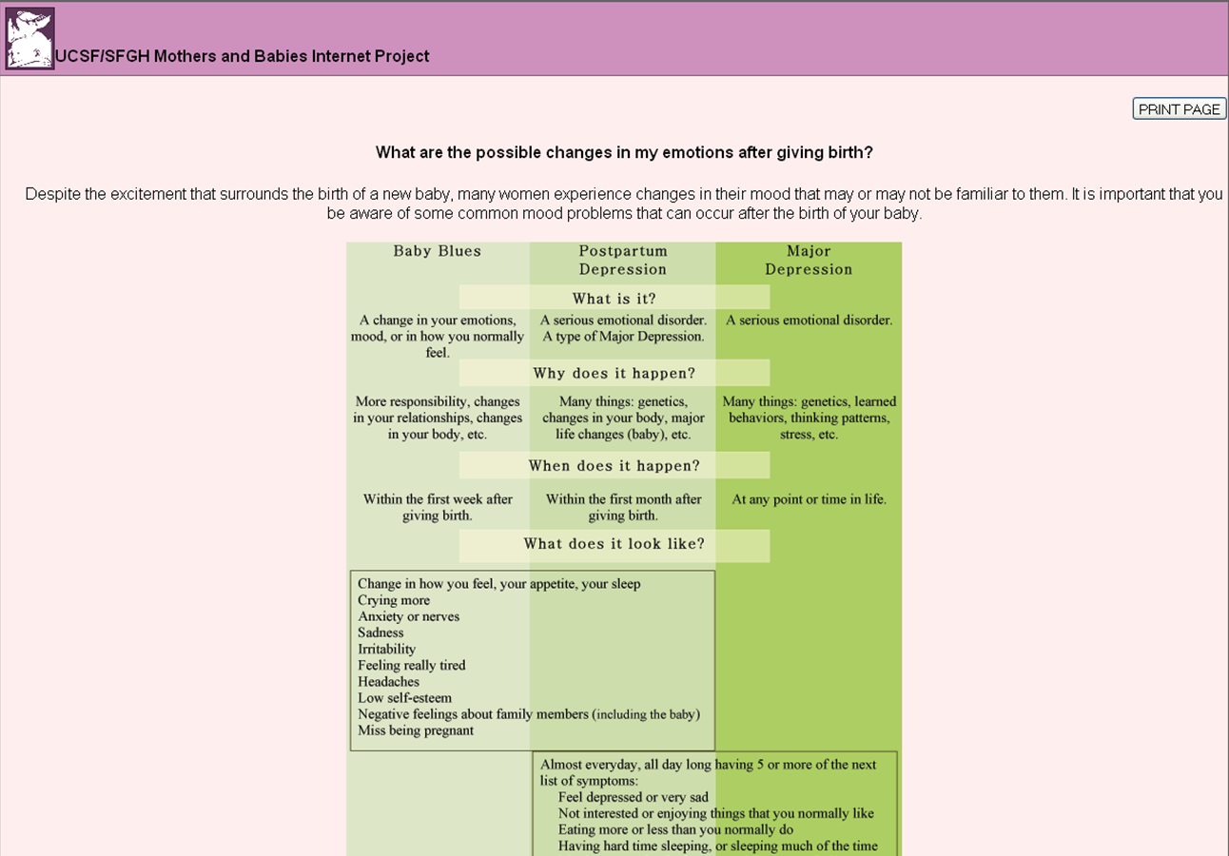
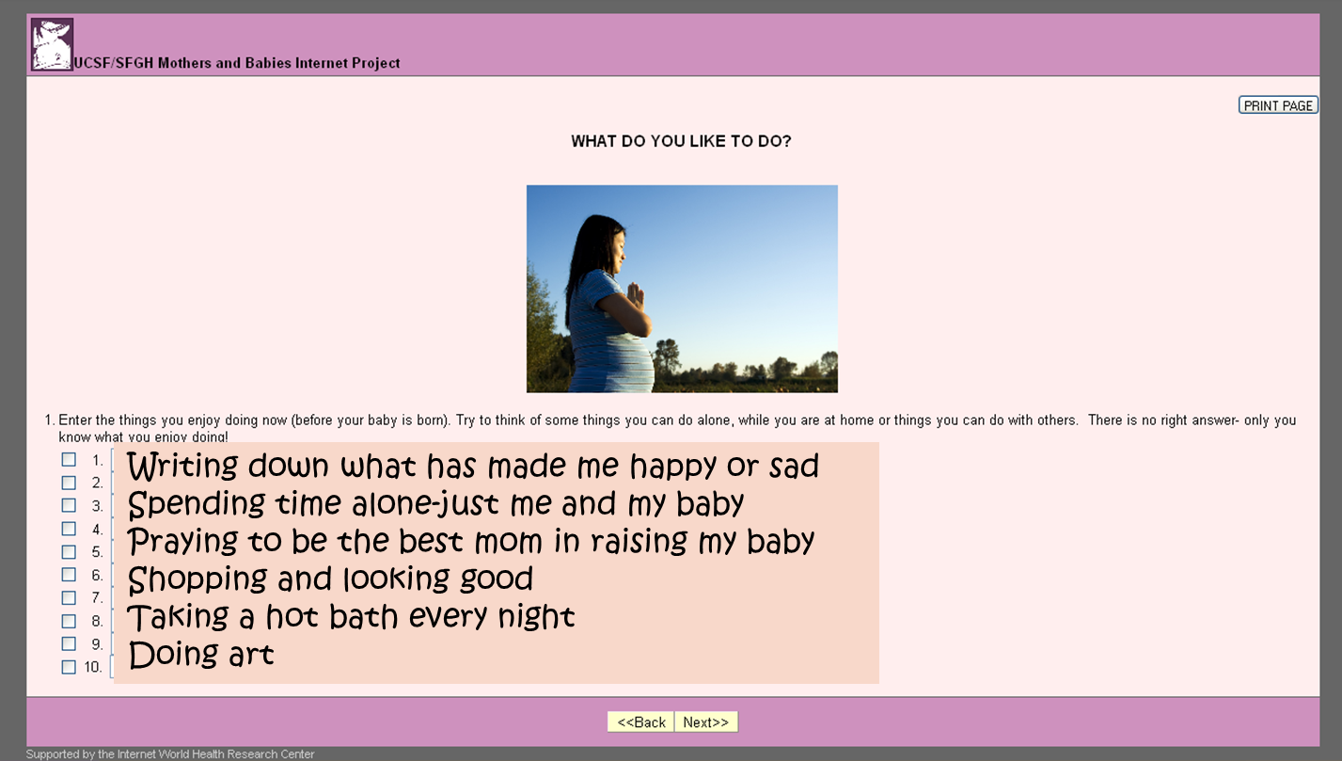
Mothers and Babies/Mamás y Bebés Internet Project

Slide 15
Procedures
Recruitment
Google ads
Baseline
Access to:
eMB Course
Info Brochure
Eligibility
Female,
18+, pregnant,
site for self
6-month postpartum follow-up
Randomization
Eligibility Screening
Baseline
  Demographics
  Pregnancy History
  Depression History (MDE Screener, CES-D)
  Randomization (real time)
Follow-up
  Monthly, up to 6 months postpartum
    Pregnancy status, MDE Screener, EPDS

Slide 16
Global community represented by 189 countries
[@ Eligibility Screening]
Spanish (n=11,945) | English (n=5,169)
13.5% Venezuela | 45.9% India
13.4% Chile/Mexico | 9.1% Pakistan
12.5% Colombia | 8.3% South Africa
10.9% Spain | 3.8% United States
11.8% Argentina | 3.5% United Kingdom
5.6% Peru | 2.2% Nigeria
4.0% Bolivia | 1.9% United Arab Emirates
3.2% Ecuador | 1.6% Kenya
2.2% Dominican Republic | 1.4% Iran
1.2% United States | 1.2% Bangladesh/Ghana
Barrera, Kelman, & Muñoz, 2014

Slide 17
Demographic Characteristics
(N=1079)
Mean Age = 27.8 years (SD=5.5)
85.3% Spanish-speaking
81.3% Latina
52.9% Married
81.7% Some college or more
Notes:
45 countries represented total

Slide 18
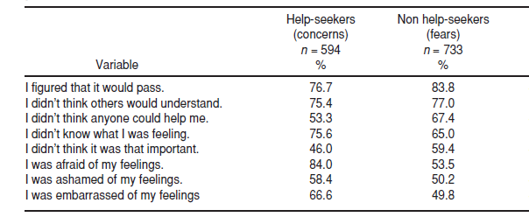
Perinatal depression help-seeking beliefs
2
3
3
1
      (Barrera & Nichols, 2015)

Slide 19
Creating community-informed Internet interventions

Slide 20
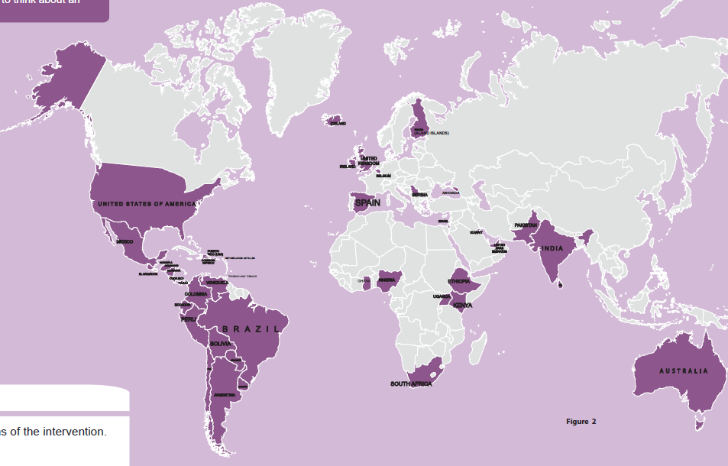
What do mothers have to say?
  …share the experiences of other mothers within the lessons, personalize it with what I can identify with…
  …I think this kind of information would be good to give to new mothers during the three days you are in the hospital, either print or digitally…
I would share it with my partner and other mothers.

Slide 21
Keeping up with Technology

Slide 22

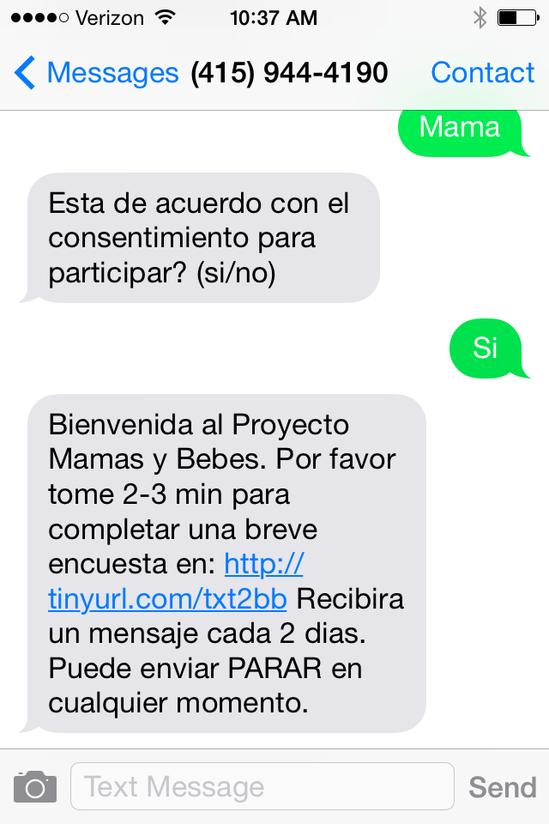
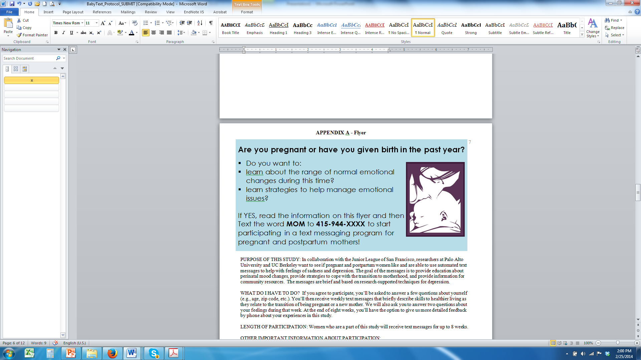
Text messaging psycho-education for perinatal depression : Feasibility study
OBJECTIVE:
Is this program acceptable and feasible?
What impact does it have on depression?
Do women seek support or treatment?

Slide 23
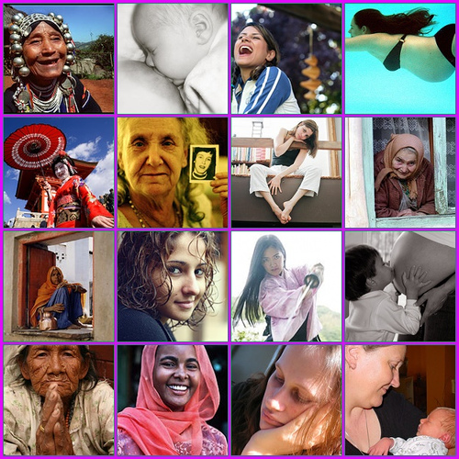
Closing
Perinatal women are interested in and use technology.
Technology-based tools can
  Be informed by the needs and preferences of perinatal Latinas
  Enhance the psychological well-being of all perinatal women
  Reach underserved and diverse communities of women locally and globally

Slide 24

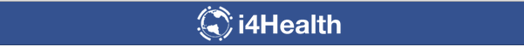
Thank you!
Alinne Barrera, Ph.D.
Assistant Professor and Associate Director of Clinical Training
Associate Director,
Institute for International Internet Interventions for Health (i4Health)
Palo Alto University
abarrera@paloaltou.edu

