Slide 1
Let’s Use
Massive Open Online Interventions (MOOIs) to Prevent Depression Worldwide
Global Consortium for Depression Prevention
Bergen, Norway, Sep 17-18, 2015
Ricardo F. Muñoz, Ph.D., Director, i4Health
Institute for International Internet Interventions for Health
Palo Alto University, Palo Alto, California, USA

Slide 2
Eugene, Oregon
September, 1972

Slide 3

Muñoz & Kelly, 1975

Slide 4

1976

Slide 5
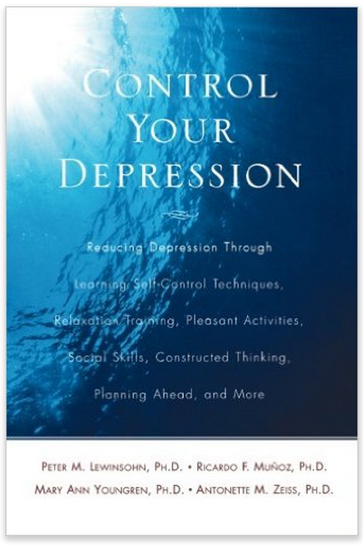
1978

Slide 6

1979

Slide 7
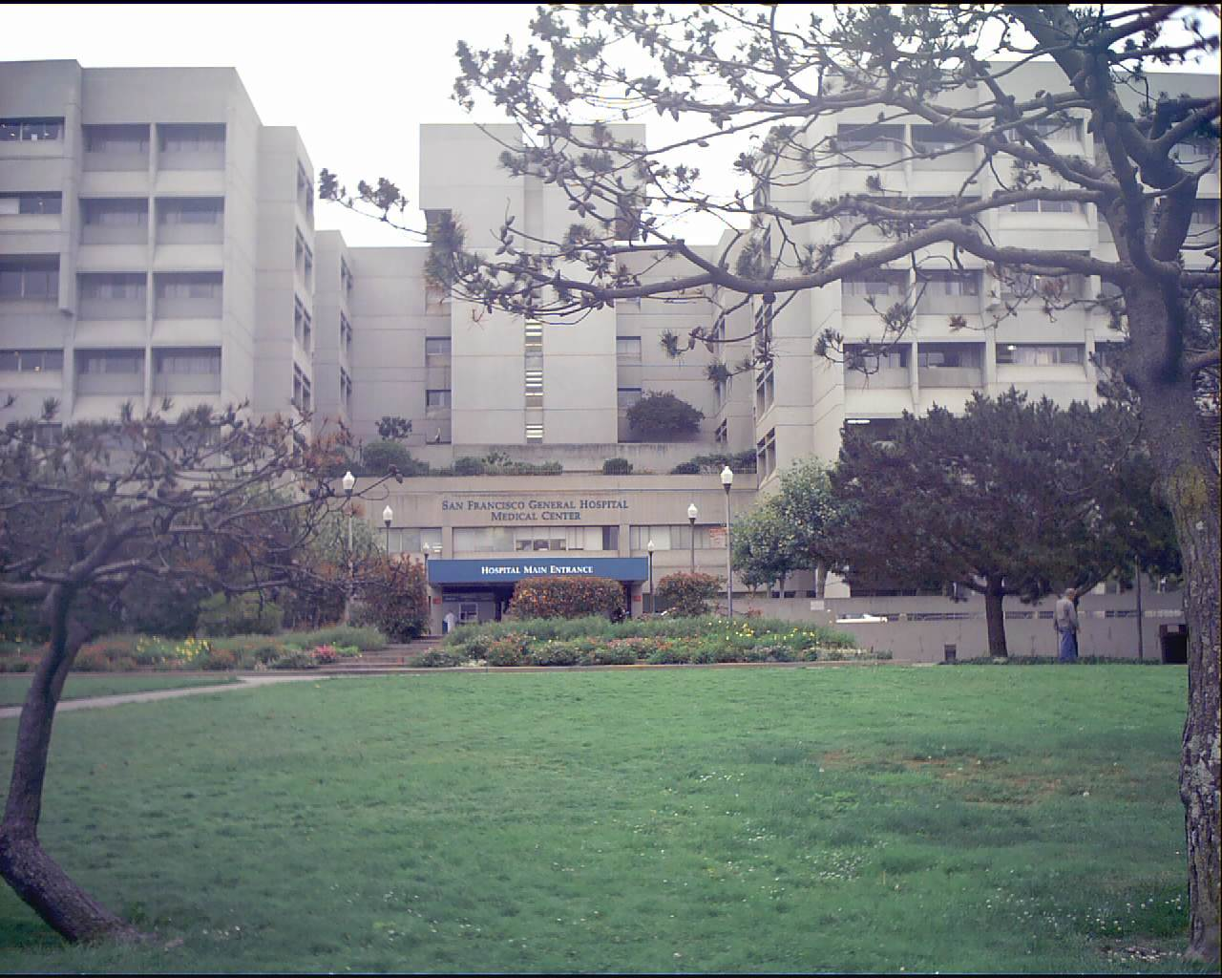
1977-now

Slide 8


Slide 9
“In general, the onset of a clinical depression cannot be prevented.”
National Institute of Mental Health public information pamphlet
Depression: What We Know
(Lobel & Hirschfeld, 1984, p. 4)

Slide 10


Slide 11


Slide 12


Institute of Medicine Reports
1994
2009

Slide 13
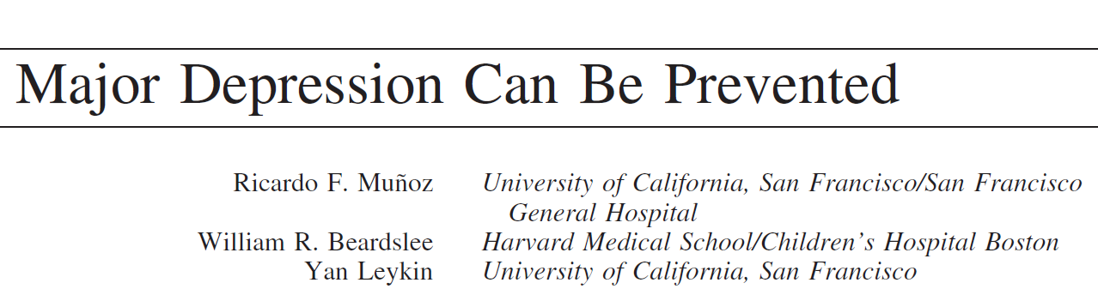
American Psychologist, 2012, 67 (4), 285–295

Slide 14
Moving toward MOOIs
Online RCT
Morph the RCT site to a participant preference site

Slide 15
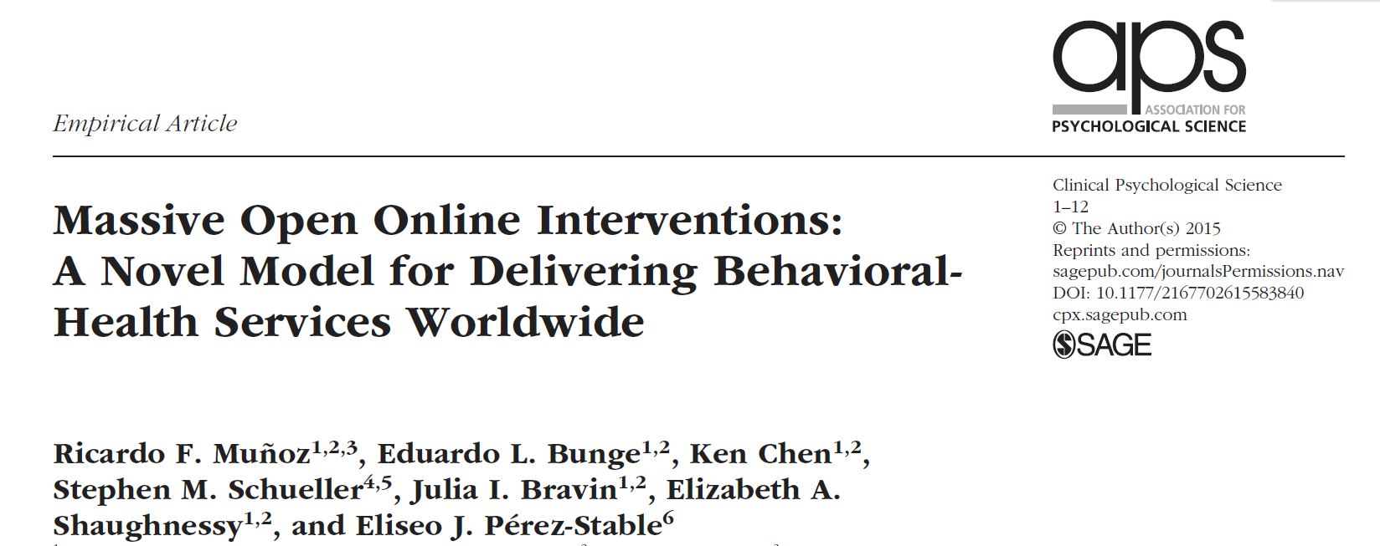
On MOOCs and MOOIs (moo-ees)
Massive Open Online Courses
Massive Open Online Interventions

Slide 16
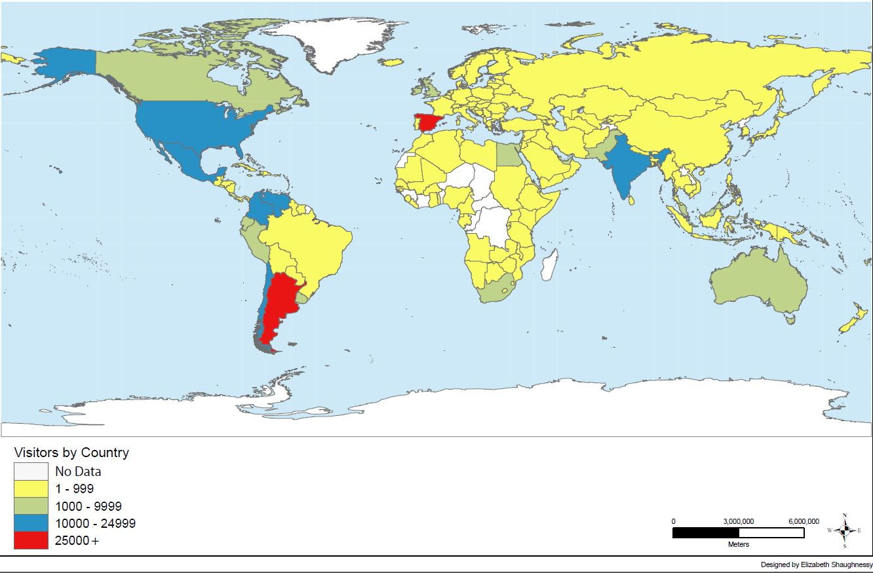
292,278 Visitors to Stop Smoking MOOI
Number of people landing on SF Stop Smoking Site after searching for smoking information via Google (2 ½ years)

Slide 17
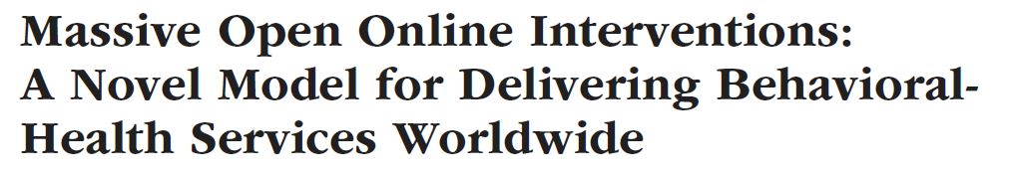
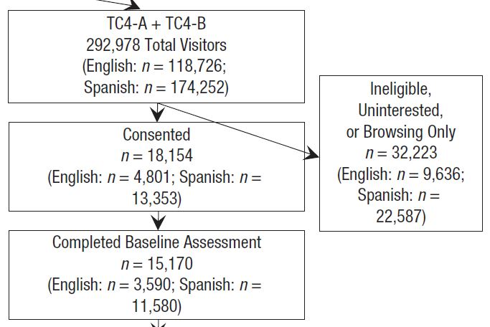

Slide 18
[All visitors received stop smoking guide]
< 18 yo

Slide 19

MOOCs & MOOIs
open to anyone globally
ideally free to hundreds of thousands participants
Self-help, automated (thus, not consumable)

Slide 20
On Attrition:
MIT MOOC on “Circuits and Electronics”
155,000 registered
23,000 tried the first problem set
9,000 passed midterm
7,157 passed course (4.6% of registered)
Attrition is also massive!

Slide 21
On Attrition:
MIT MOOC on “Circuits and Electronics”
155,000 registered
23,000 tried the first problem set
9,000 passed midterm
7,157 passed course (4.6% of registered) [Do you find this disappointing?]
Attrition is also massive!

Slide 22
But…
“…if you look at the number in absolute terms, it's as many students as might take the course in 40 years at MIT.”
Anant Agarwal,
quoted by Hardesty, 2012

Slide 23
But…
“…if you look at the number in absolute terms, it's as many students as might take the course in 40 years at MIT.”
Anant Agarwal,
quoted by Hardesty, 2012
7,157 passed the course!

Slide 24
3,479 smokers using our website
across the world
gave us data
indicating they had quit

Slide 25
3,479 smokers using our website
across the world
gave us data
indicating they had quit
To help that many smokers quit, it would have taken:
$3,652,950 worth of nicotine patches
69.6 years of a smoking cessation counselor working full time

Slide 26
3,479 smokers using our website
across the world
gave us data
indicating they had quit
To help that many smokers quit, it would have taken:
$3,652,950 worth of nicotine patches
69.6 years of a smoking cessation counselor working full time
We were able to do this in 2½ years, for approximately $200,000 by keeping a research site open after the grant ended.

Slide 27
Consent as a barrier
 | Spanish | English | Total
Eligible | 27,152 | 8,915 | 36,067
Consented | 13,615 | 4,858 | 18,473

Slide 28
Consent as a barrier
 | Spanish | English | Total
Eligible | 27,152 | 8,915 | 36,067
Consented | 13,615 | 4,858 | 18,473
Half of those eligible do not consent.

Slide 29
Consent as a barrier
 | Spanish | English | Total
Eligible | 27,152 | 8,915 | 36,067
Consented | 13,615 | 4,858 | 18,473
Why not let people who do not consent use the site?

Slide 30
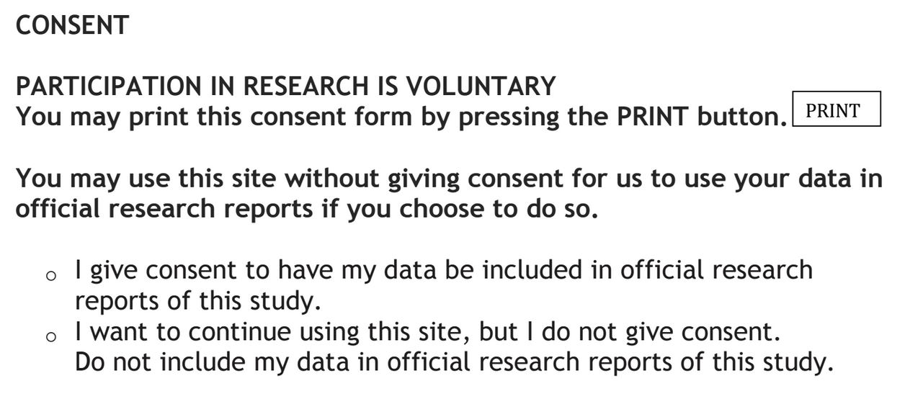

Slide 31

Global Reach = 189 countries
Mothers and Babies Internet Project
Spanish (n=11,945) | English (n=5,169)
13.5% Venezuela | 45.9% India
13.4% Chile/Mexico | 9.1% Pakistan
12.5% Colombia | 8.3% South Africa
10.9% Spain | 3.8% United States
11.8% Argentina | 3.5% United Kingdom
5.6% Peru | 2.2% Nigeria
4.0% Bolivia | 1.9% United Arab Emirates
3.2% Ecuador | 1.6% Kenya
2.2% Dominican Republic | 1.4% Iran
1.2% United States | 1.2% Bangladesh/Ghana
Barrera, Kelman, & Muñoz, 2014

Slide 32
Depression on the internet: automated tools for screening and intervening
Yan Leykin, PhD
Associate Professor
Palo Alto University

Slide 33

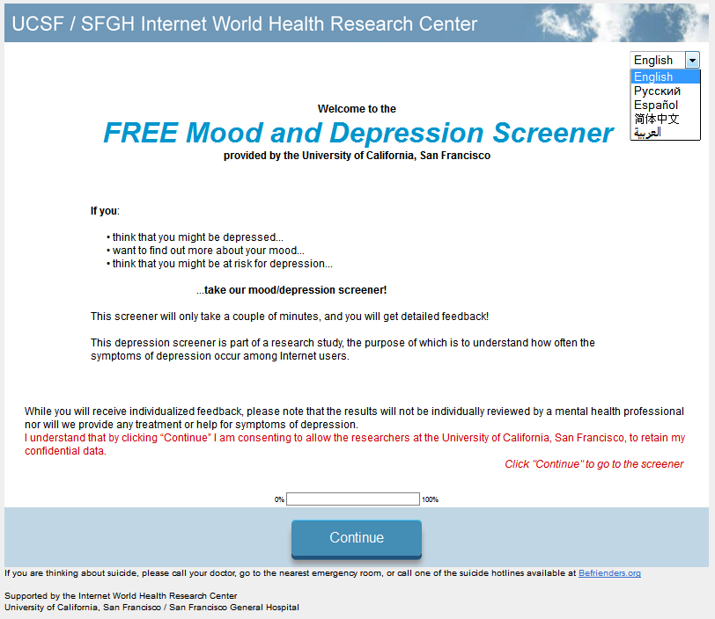
Mood Screener
Who searches for depression information online?

Slide 34






Broad recruitment
Anyone 18+ years of age
Google AdWords

Slide 35
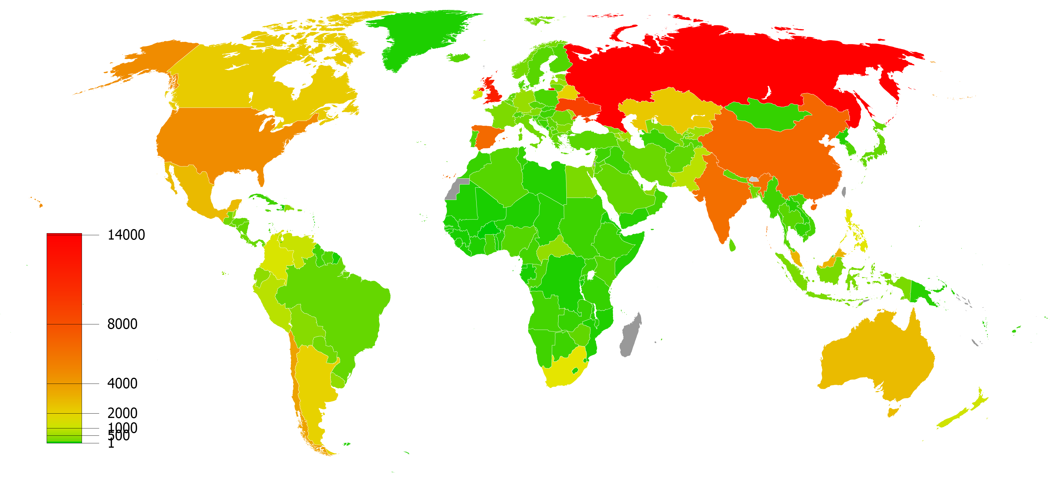
Worldwide reach
  231 countries and territories represented

Slide 36
Massive sample
 | English | Spanish | Russian | Chinese | Arabic
Visitors | 215,000 | 37,000 | 79,000 | 38,000 | 45,000
% eligible | 79% | 87% | 67% | 71% | 75%
Screened for current depression | 77,000 | 17,500 | 24,000 | 9,500 | 10,500
Not eligible = under 18 years old
http://tiny.ucsf.edu/mood_screener

Slide 37
Massive sample
 | English | Spanish | Russian | Chinese | Arabic
Visitors | 215,000 | 37,000 | 79,000 | 38,000 | 45,000
% eligible | 79% | 87% | 67% | 71% | 75%
Screened for current depression | 77,000 | 17,500 | 24,000 | 9,500 | 10,500
Not eligible = under 18 years old
% under 18 years old | 21% | 13% | 33% | 29% | 25%
http://tiny.ucsf.edu/mood_screener

Slide 38
Rates of depression and suicide
In the past 2 weeks…

Slide 39
Who is in treatment?
How many report current antidepressants or psychotherapy?
Current depression

Slide 40
Who is in treatment?
How many report current antidepressants or psychotherapy?
Current depression
L or VL to commit
suicide in next days

Slide 41
Call for Action:
Let’s fill in a grid of “MOOIs”
 | Smoking | Depression | Sleep | Pain | …
English
Spanish
Chinese
Arabic
…

Slide 42
Using MOOIs we could heal and prevent depression worldwide

Slide 43
Using MOOIs we could heal and prevent depression worldwide

Slide 44
What are our options?

Slide 45
ODIN
Community outreach
Primary care screening
MOOIs (self-help, automated)
MOOIs with tools for local helpers
Guided digital interventions
Mental health specialty services
Health and Mental Health services plus digital adjuncts

Slide 46
ODIN
Community outreach
Primary care screening
MOOIs (self-help, automated)
MOOIs with tools for local helpers
Guided digital interventions
Mental health specialty services
Health and Mental Health services plus digital adjuncts
Greater cost

Slide 47
Greater number of people helped
ODIN
Community outreach
Primary care screening
MOOIs (self-help, automated)
MOOIs with tools for local helpers
Guided digital interventions
Mental health specialty services
Health and Mental Health services plus digital adjuncts
Greater cost

Slide 48
MOOIs as a basic level of care
MOOIs alone
MOOIs + local helpers
MOOIs + paid coaches
MOOIs as adjuncts

Slide 49
MOOIs

Slide 50
Face-to-face
and Live Services
MOOIs

Slide 51

Guided adjuncts
(Live coaches: email, phone, hosted sites)
MOOIs

Slide 52
Face-to-face
and Live Services
Guided Adjuncts
MOOIs

Slide 53
No Gaps
MOOIs

Slide 54

Blanketing the world with MOOIs
to help as many people as possible.

